Slide 1
Photo Enhancement

Slide 2
Super-Resolution
Dehazing
Denoising
GAN-CNN

Slide 3



Super-Resolution
SRCNN
First upscale it to the desired size as Y
X = F(Y)
Similar to the ground truth high-resolution image
PSNR
Peak Signal to Noise Ratio
这里的MAX通常是图像的灰度级，一般是255

Slide 4
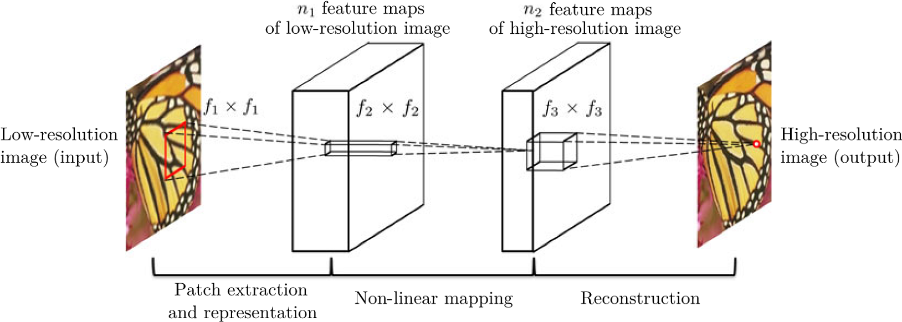
patch extraction and representation
non-linear mapping
Reconstruction

Slide 5
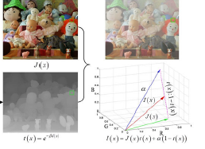
Dehazing
I(x) = J(x)t(x) +a (1-t(x))
反射光 J(x), 媒介透射率t(x) ,大气光a

Slide 6
Dehazing
暗通道先验（DCP, Dark Channel Prior）：以简洁有效的先验假设解决了雾霾浓度估计问题。观察发现，清晰图像块的RGB颜色空间中有一个通道很暗（数值很低甚至接近于零）。因此基于暗通道先验，雾的浓度可由最暗通道的数值近似表示。
最大对比度：根据大气散射模型，雾霾会降低物体成像的对比度。因此，基于这个推论可利用局部对比度来近似估计雾霾的浓度。同时，也可以通过最大化局部对比度来还原图像的颜色和能见度。

Slide 7
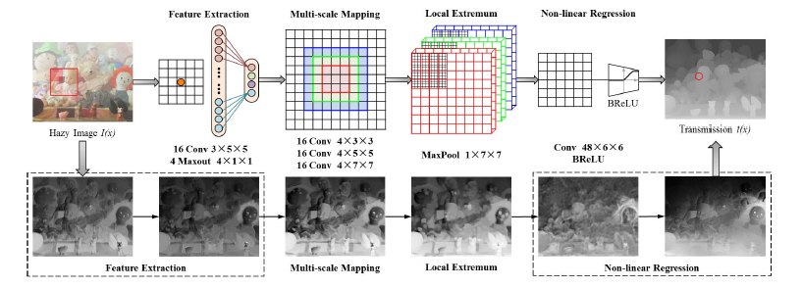
特征提取
多尺度映射：提高不同分辨率下的鲁棒性
局部极值：透射率的局部一致性，抑制透射率的估计噪声

Slide 8
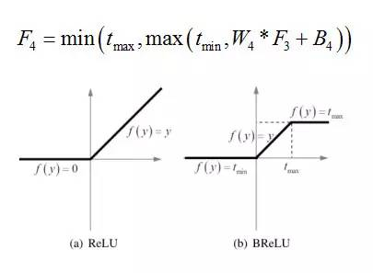
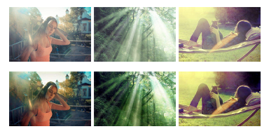

BRELU: 在双边约束的同时，保证局部的线性，对应于传统去雾方法中的边缘抑制操作。
Reconstruction

Slide 9

Denoising
Noisy observation y = x + v
learn a mapping function F(y) = x to predict the latent clean image.
DNCNN, we adopt the residual learning formulation to train a residual mapping R(y) = v, and then we have x = y -R(y)
Loss function

Slide 10
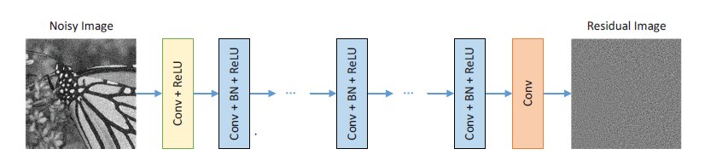
Conv1（c * 3 * 3 * 64）+ReLu （c: Image channels）
Conv2（64 * 3 * 3 * 64）+BN(Batch Normalization)+ReLu
Conv3（64 * 3 * 3 *c）
the integration of residual learning and batch normalization can not only speed up and stabilize the training process but also boost the denoising performance.

Slide 11
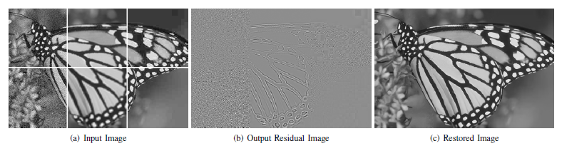

RCNN : shortcut connection
Residual learning:并非每隔两层就加一个shortcut connection，而是将网络的输出直接改成residual image.
当残差为0时，堆积层之间等价于恒等映射，非常容易训练优化.
噪音图片与纯净图片的残差非常小.

Slide 12
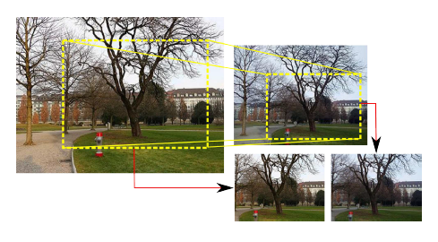
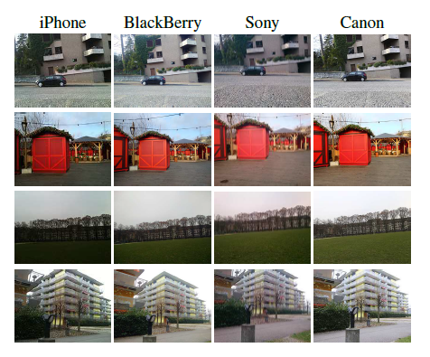
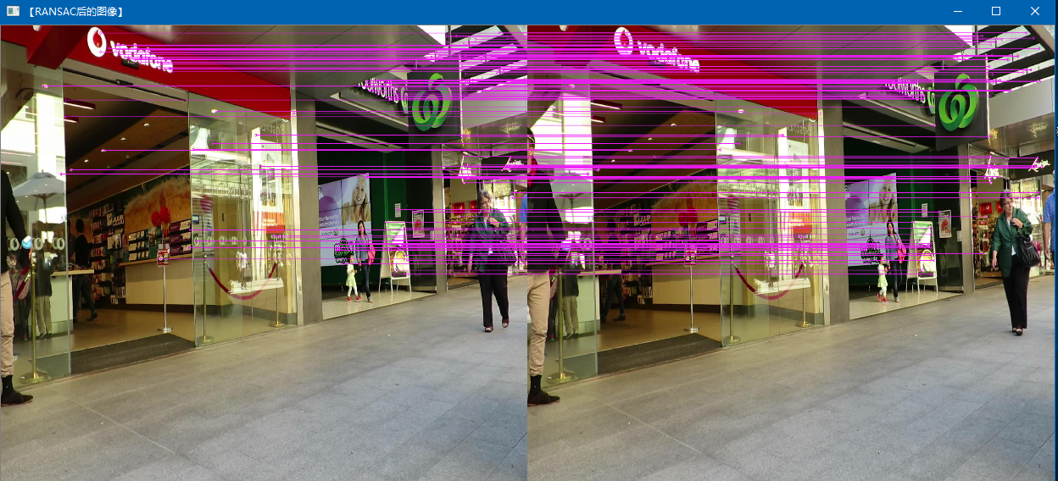
DSLR-Quality Photos
特征匹配结果
DSLR Photo Enhancement Dataset (DPED) ：22k photos
Pre-process：Matching images，SIFT，SURF

Slide 13
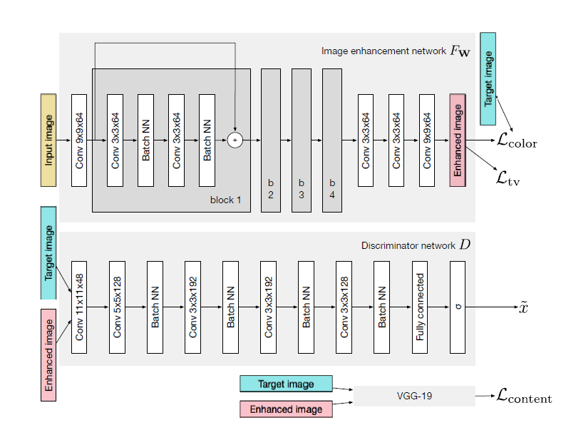

Slide 14





Color loss : applying a Gaussian blur and computing Euclidean distance between the obtained representations
Texture loss : GAN applied to grayscale images.
Content loss: ψj be the feature map obtained after the j-th convolutional layer of the VGG-19 CNN.
Total variation loss: enforce spatial smoothness of the produced images

